Slide 1






ThinkRec: Thinking-based Recommendation via LLM
（WWW-2026)
code https://github.com/Yu-Qi-hang/ThinkRec
Reported by Jiale Shen

Slide 2
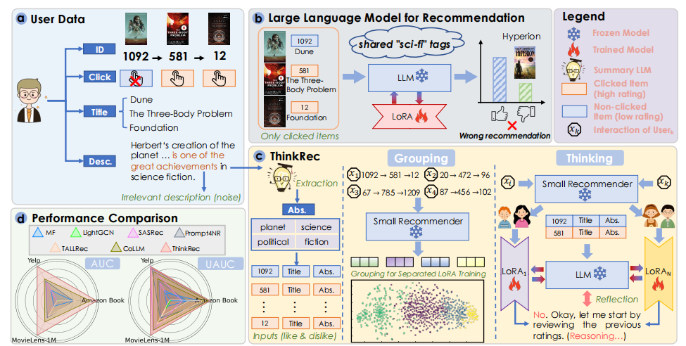
motivation
1.Relying solely on click history for simple superficial feature matching is akin to an intuitive response. This approach is easily misled by surface-level phenomena while overlooking the underlying behavioral logic of users.
2.Traditional recommendation task data and optimization objectives which often focus solely on outcomes, lacking the process that activates LLM's deep reasoning

Slide 3
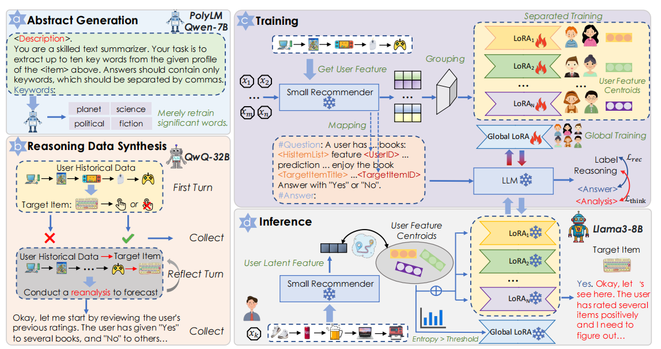
Overview

Slide 4
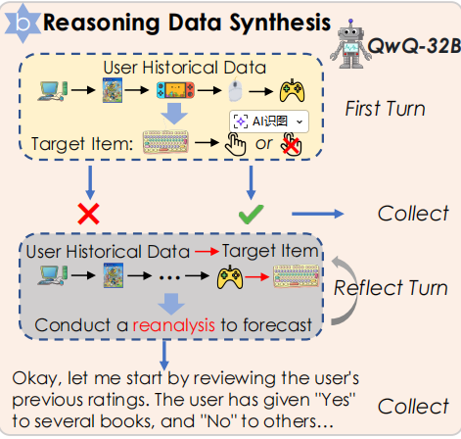



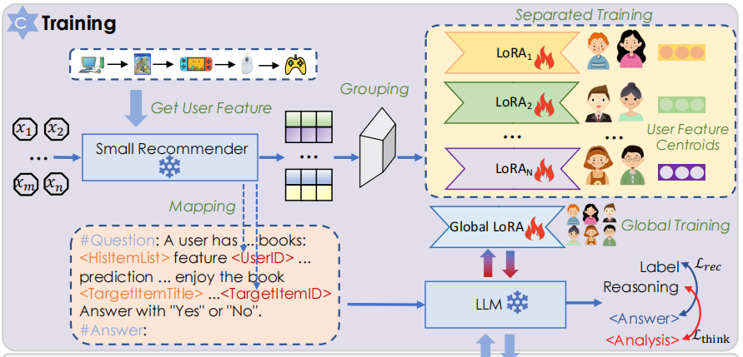

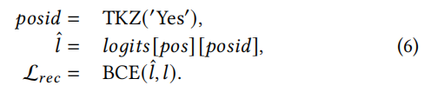

Approach

Slide 5
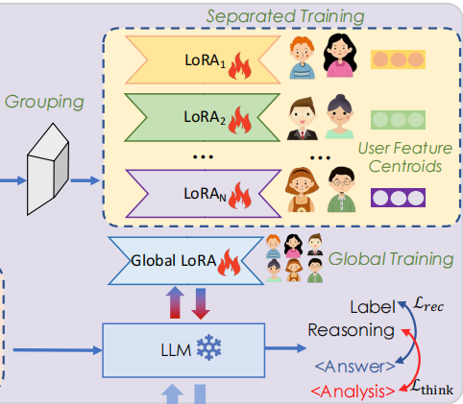


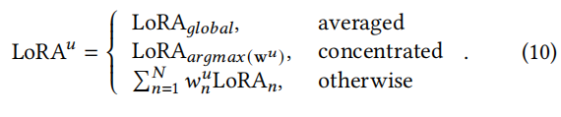
Approach

Slide 6
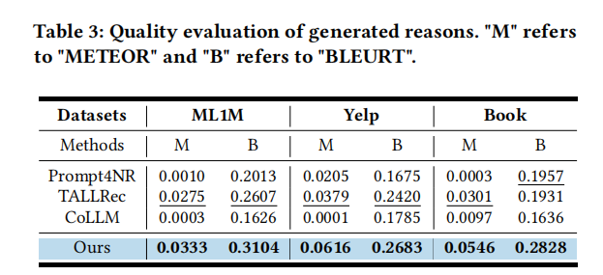
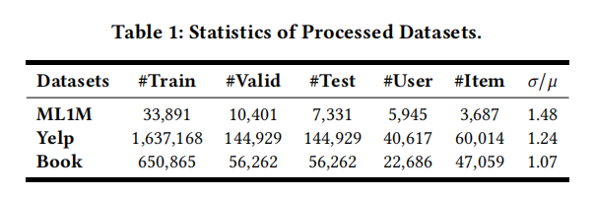
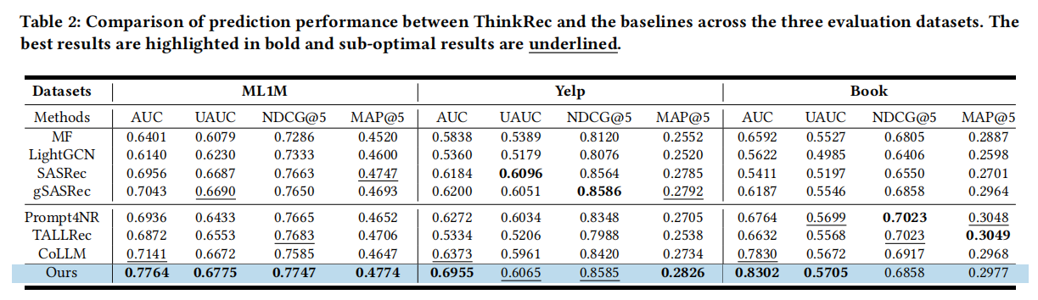
Experiment

Slide 7
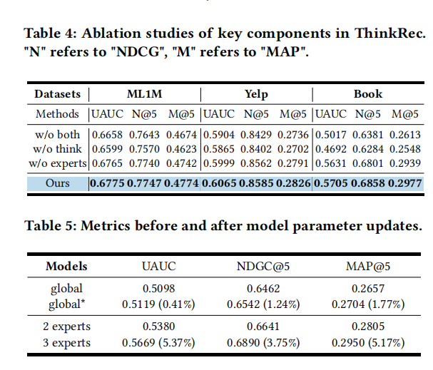
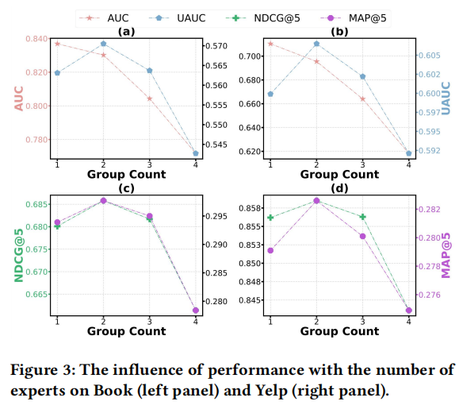
Experiment

Slide 8
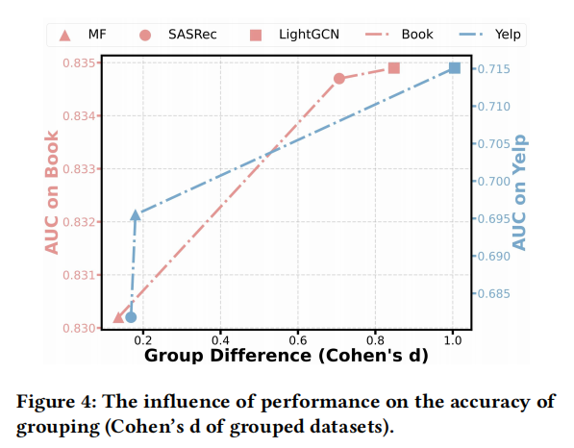
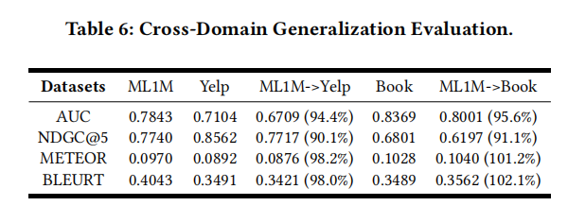
Experiment

Slide 9
Thank you!

